Slide 1
IMPROVING MECHANISTIC REPRESENTATION OF ARCTIC CARBON DYNAMICS USING DATA ASSIMILATION
PI: Andrew M Fox
Co-I: David JP Moore, William K Smith
University of Arizona

Slide 2
Science Objectives
“How are the magnitudes, fates, and land-atmosphere exchanges of carbon pools responding to environmental change, and what are the biogeochemical mechanisms?”
Improve the mechanistic representation of biogeochemical processes within the Community Earth System Model (CESM) to evaluate whether warming in the arctic has and is likely to cause amplifying feedbacks to climate

Slide 3
Science Approach
Use data assimilation to ensure that the Community Land Model agrees with well tested historical remote sensing products (NDVI and inferred LAI) across ABoVE domain
And then incorporate collections of biophysical observations and SIF and ABoVE data collections
But where the tuned model disagrees with observations we can infer a biogeochemical mechanism is mis-parameterized
Therefore by revising the mechanisms in the model we can test hypotheses and improve representation

Slide 4
Science Approach
Use data assimilation to ensure that the Community Land Model agrees with well tested historical remote sensing products (NDVI and inferred LAI) across ABoVE domain
And then incorporate collections of biophysical observations and SIF and ABoVE data collections
But where the tuned model disagrees with observations we can infer a biogeochemical mechanism is mis-parameterized
Therefore by revising the mechanisms in the model we can test hypotheses and improve representation

Slide 5
Science Approach
Use data assimilation to ensure that the Community Land Model agrees with well tested historical remote sensing products (NDVI and inferred LAI) across ABoVE domain
And then incorporate collections of biophysical observations and SIF and ABoVE data collections
But where the tuned model disagrees with observations we can infer a biogeochemical mechanism is mis-parameterized
Therefore by revising the mechanisms in the model we can test hypotheses and improve representation

Slide 6
Science Approach
Use data assimilation to ensure that the Community Land Model agrees with well tested historical remote sensing products (NDVI and inferred LAI) across ABoVE domain
And then incorporate collections of biophysical observations and SIF and ABoVE data collections
But where the tuned model disagrees with observations we can infer a biogeochemical mechanism is mis-parameterized
Therefore by revising the mechanisms in the model we can test hypotheses and improve representation

Slide 7
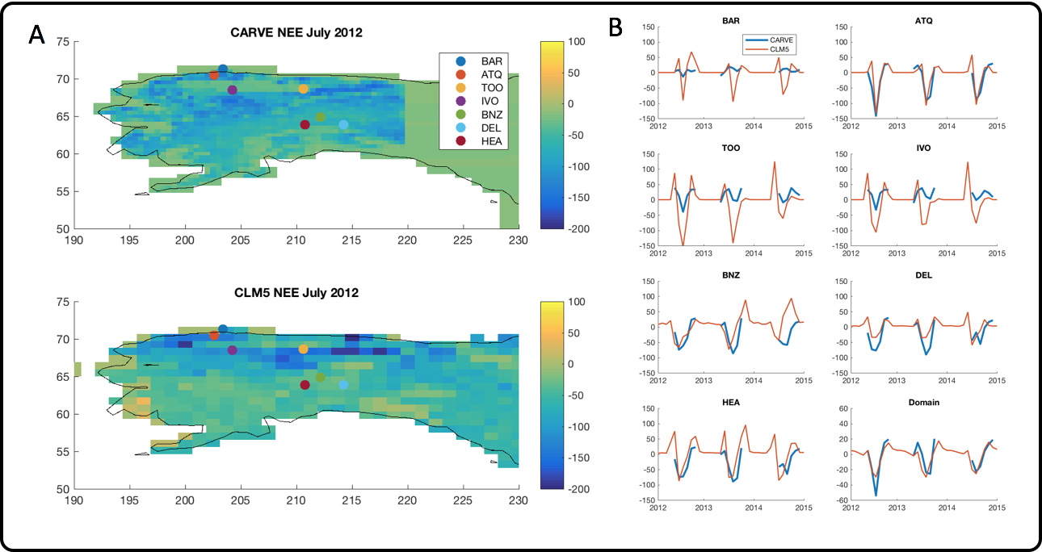
Current Model Performance
Notes:
Our data assimilation system brings together CESMl, one of the most highly developed and extensively used ESMs with a leading-edge, community ensemble data assimilation tool, the Data Assimilation Research Testbed (DART). Together, they represents one of the most advanced DA systems yet developed for such a complete, coupled ESM.

Slide 8
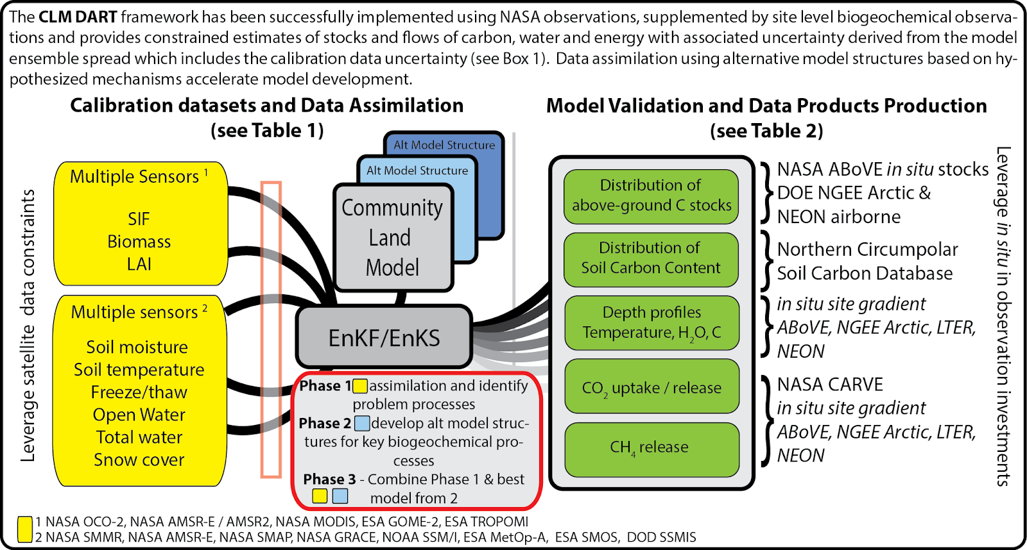
Modeling & Data Assimilation
Notes:
Our data assimilation system brings together CESMl, one of the most highly developed and extensively used ESMs with a leading-edge, community ensemble data assimilation tool, the Data Assimilation Research Testbed (DART). Together, they represents one of the most advanced DA systems yet developed for such a complete, coupled ESM.

Slide 9
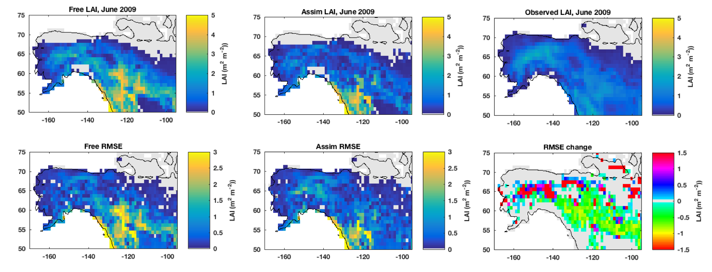
Preliminary Data Assimilation
10 years of MODIS LAI observations were assimilated into CLM. Comparing the free run (no assimilation) with the assimilation run mean error is reduced only by about 0.5 m² m⁻².

Slide 10
Stakeholder Engagement
Community Earth System Model is one of the most important contributors to the Coupled Model Intercomparison Project
These suite of models are used by governments and non-governmental organizations the world over to inform climate-change policy

Slide 11
Stakeholder Engagement
CLM and DART are open-source, community tools available to all from Git repositories
But need to ensure that our model improvements are integrated into the main branches of the distributions, and incorporated into future releases of CESM
Build user engagement at annual CLM Working Group and CESM Workshop meetings, and direct interaction with NCAR scientists

Slide 12
Stakeholder Engagement
CLM and DART are open-source, community tools available to all from Git repositories
Ensure that our model improvements are integrated into the main branches of the distributions, and incorporated into future releases of CESM
Annual CLM Working Group and CESM Workshop meetings, and direct interaction with NCAR scientists

